Slide 1
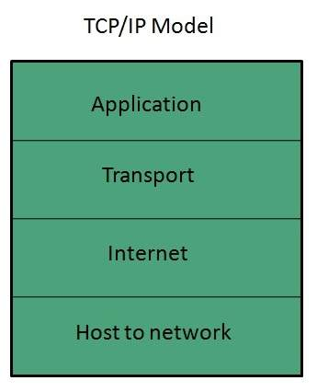
TCP/IP Model
TCP/IP Model
TCP/IP model is practical model and is used in the Internet. TCP/IP is acronym of Transmission Control Protocol and Internet Protocol.
The TCP/IP model combines the two layers (Physical and Data link layer) into one layer i.e. Host-to-Network layer. The following diagram shows the various layers of TCP/IP model:

Slide 2
Application Layer
This layer is same as that of the OSI model and performs the following functions:
It provides different services such as manipulation of information in several ways, retransferring the files of information, distributing the results etc.
The functions such as LOGIN or password checking are also performed by the application layer.
Protocols used: TELNET, FTP, SMTP, DN, HTTP, NNTP are the protocols employed in this layer.
Transport Layer
It does the same functions as that of transport layer in OSI model. Here are the key points regarding transport layer:
It uses TCP and UDP protocol for end to end transmission.
TCP is reliable and connection oriented protocol.
TCP also handles flow control.
The UDP is not reliable and a connection less protocol also does not perform flow control.
Protocols used: TCP/IP and UDP protocols are employed in this layer.

Slide 3
Internet Layer
The function of this layer is to allow the host to insert packets into network and then make them travel independently to the destination. However, the order of receiving the packet can be different from the sequence they were sent.
Protocols used: Internet Protocol (IP) is employed in Internet layer.
Host-to-Network Layer
This is the lowest layer in TCP/IP model. The host has to connect to network using some protocol, so that it can send IP packets over it. This protocol varies from host to host and network to network.
Protocols used: ARPANET, SATNET(Satellite network), LAN, packet radio are the protocols which are used in this layer.

Slide 4
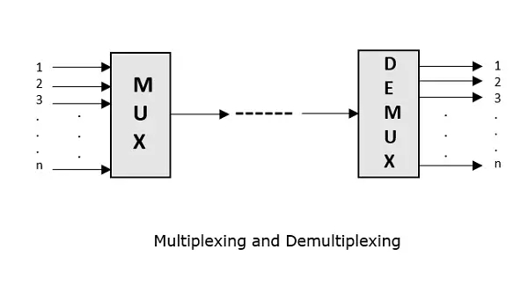
Multiplexing
Multiplexing is the process of combining multiple signals into one signal, over a shared medium. If analog signals are multiplexed, it is Analog Multiplexing and if digital signals are multiplexed, that process is Digital Multiplexing.
The process of multiplexing divides a communication channel into several number of logical channels, allotting each one for a different message signal or a data stream to be transferred. The device that does multiplexing can be simply called as a MUX while the one that reverses the process which is demultiplexing, is called as DEMUX.

Slide 5
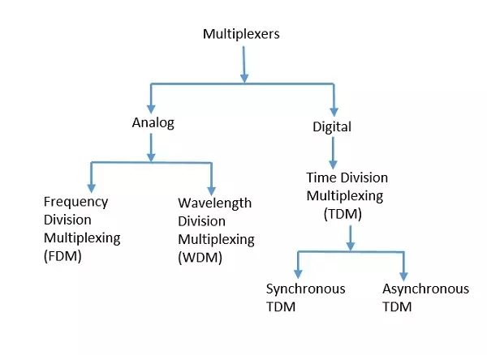
Types of Multiplexers
There are mainly two types of multiplexers, namely analog and digital. They are further divided into FDM, WDM, and TDM.

Slide 6
Analog Multiplexing
The analog multiplexing techniques involve signals which are analog in nature. The analog signals are multiplexed according to their frequency (FDM) or wavelength (WDM).
Frequency Division Multiplexing (FDM)
In analog multiplexing, the most used technique is Frequency Division Multiplexing FDM. This technique uses various frequencies to combine streams of data, for sending them on a communication medium, as a single signal.
Example: A traditional television transmitter, which sends a number of channels through a single cable, uses FDM.
Wavelength Division Multiplexing (WDM)
Wavelength Division Multiplexing is an analog technique, in which many data streams of different wavelengths are transmitted in the light spectrum. If the wavelength increases, the frequency of the signal decreases.
Example: Optical fiber Communications use the WDM technique, to merge different wavelengths into a single light for the communication.

Slide 7
Digital Multiplexing
The term digital represents the discrete bits of information. Hence the available data is in the form of frames or packets, which are discrete.
Time Division Multiplexing (TDM)
In TDM, the time frame is divided into slots. This technique is used to transmit a signal over a single communication channel, with allotting one slot for each message. Of all the types of TDM, the main ones are Synchronous and Asynchronous TDM.
Synchronous TDM
In Synchronous TDM, the input is connected to a frame. If there are ‘n’ number of connections, then the frame is divided into ‘n’ time slots. One slot is allocated for each input line. In this technique, the sampling rate is common to all signals and hence same clock input is given. The mux allocates the same slot to each device at all times.
Asynchronous TDM
In Asynchronous TDM, the sampling rate is different for each of the signals and the clock signal is also not in common. If the allotted device, for a time-slot, transmits nothing and sits idle, then that slot is allotted to another device, unlike synchronous.

